Slide 1

Operator-Framework Workshop
Using a real-world operator

Slide 2
How users experience operators

Slide 3
For the most part, the operator is transparent
Operators codify operational knowledge of a platform/software
Users experience/benefit from the end-result of that effort
Users shouldn’t have to go find an appropriate container image, figure out how it accepts configuration, etc.
End Goal: kubectl apply -f <thing>.yaml
Enable users to declare the desired state of your application. Your operator handles the operational knowledge.

Slide 4

A self-guided demo - The Etcd Operator
https://learn.openshift.com/operatorframework/etcd-operator/

Slide 5
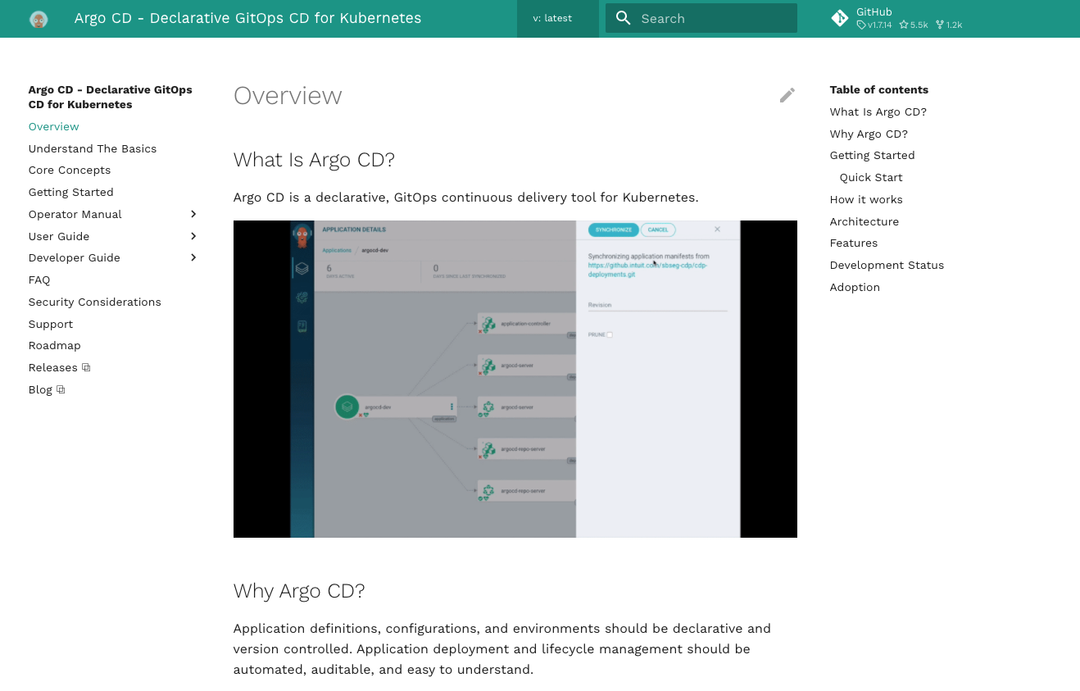
A guided demo - ArgoCD

Slide 6

A guided demo - ArgoCD
What we will do
How to install an ArgoCD Cluster in an openshift cluster
Review the declarative spec for the ArgoCD
A quick peek at the custom resource definition
Understanding the difference between the Operator and Operand
Review distinctions between operator managed resources and kubernetes-native applications

Slide 7
Demo Time!
Wish us luck!

Slide 8
The end!
Real World operators

